Slide 1
Calculating the Interpolation for the midpoint -SHJ /DXB Data using python in arcgis pro (temperature)

Slide 2
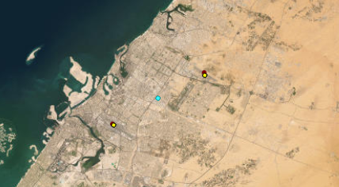
i defined the dxb and shj ariports as points in the map
And also we have the midpoint defined there to do the next step which is searching for such a measremaent ( for my case I used the avg temp) to be calc from the 2 ariports temps using the linear interpolation method

Slide 3
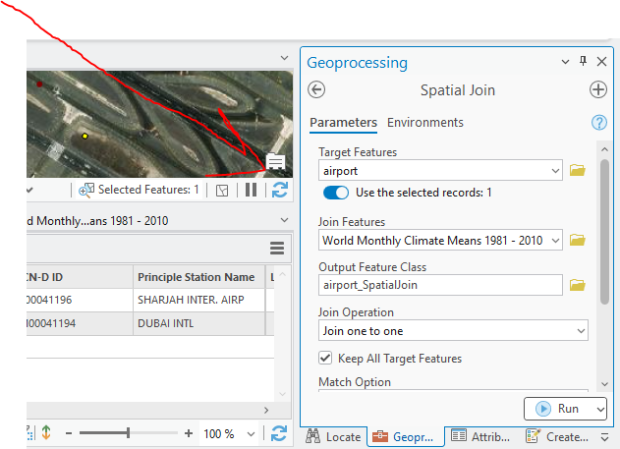
I applyied the spatial join tool to clip the data set that I have choseen
So now I have the a new layer in the map with attribute table

Slide 4
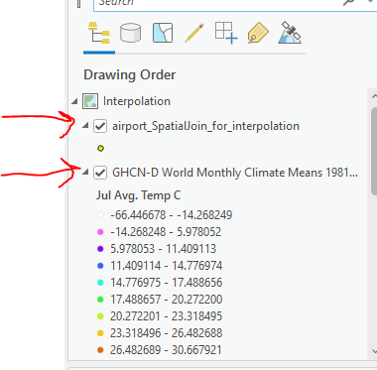
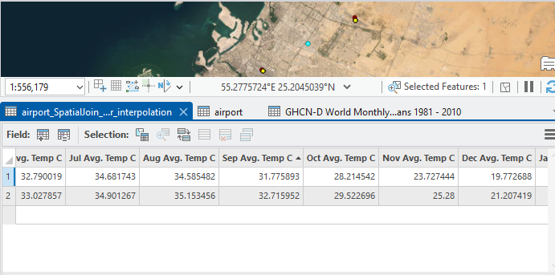
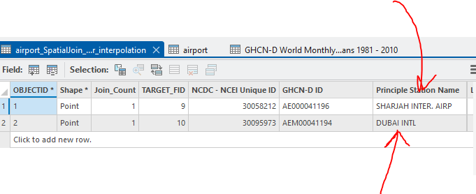
Now we had the layers and the produced attribute table
So now the avg and all temp values that are in the table are calculated for shj and dxb so we can now start with the python script to use the values in the table in our calc

Slide 5
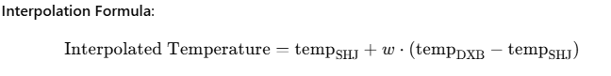
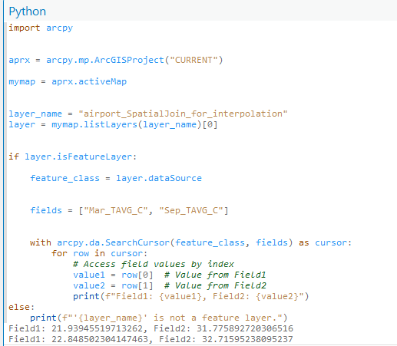
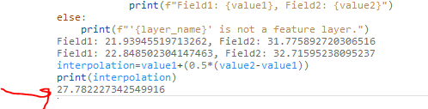

Slide 6
Worked also with prof trarek .m (college of eng) in (obtain DEM files from tiff files) but still need to continue working after we meet again due to some isssues and this photo giving some of the progress and I used a hillshade algorthim to do this to make it able to have hydrology simulation later

Slide 7
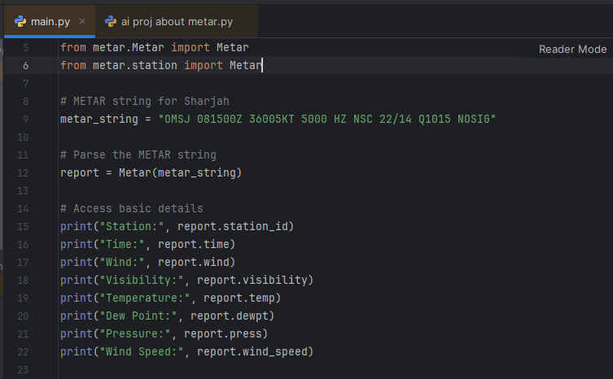
I worked also with pycharm for metar data observation like weather observ using python

Slide 8
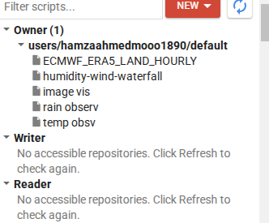
And worked with GEE for also gis and earth observ using javascript and python and drawing grapghs and doing many things

Slide 9
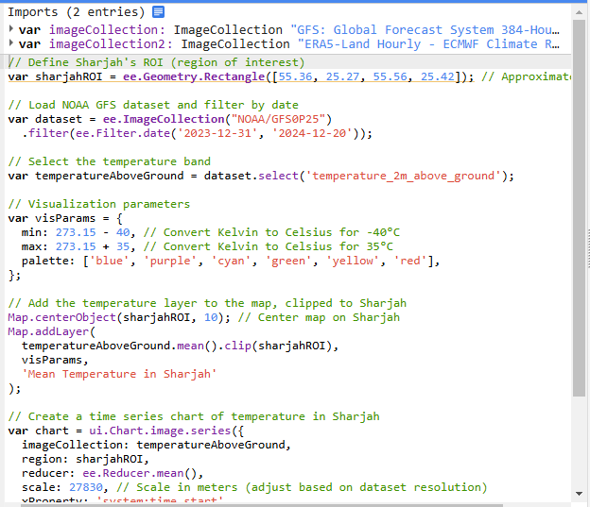
This code was for obtaining temp for shj and creating a chart for displaying the result

Slide 10
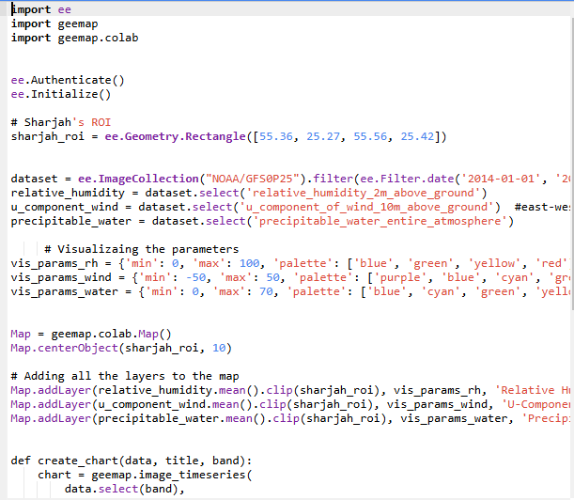
And this code Is for calculating the relative humidity and wind comp and water fall and priniting the charts for each one

Slide 11
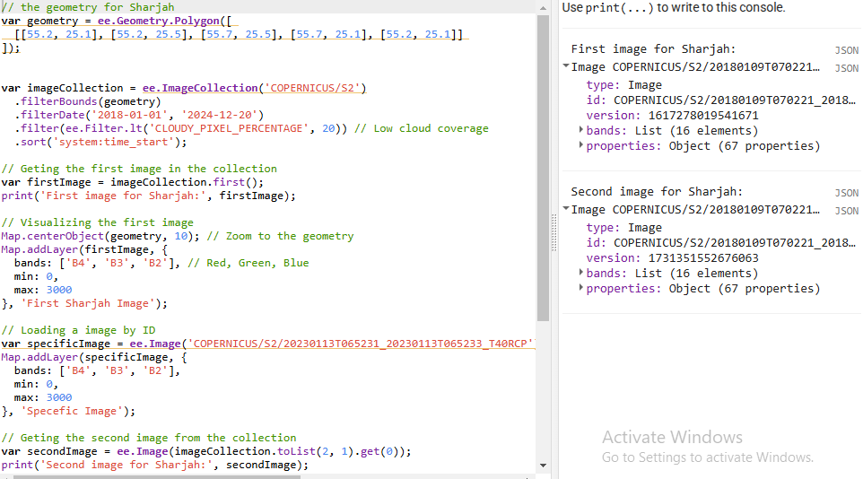
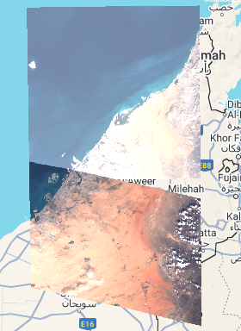
This is about img visualization using js and display thim in the map and working with map layers and bands and also combining imgs

Slide 12
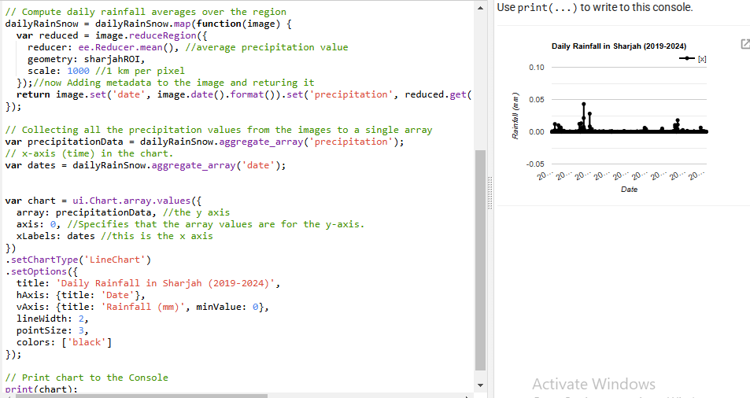
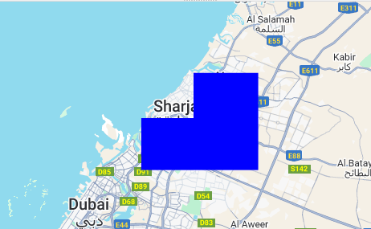
Calculating the temp for the last 5 years hourly and display a chart for it using js and generating a map layer for the resulted area

